Slide 1
convenor report
multimediatest 2021

Slide 2
Multimediatest 2021
In what country were these photographs taken?
Questions proposed by many countries this year!
Pretesting at Utrecht University of Applied Sciences (Teacher Training Institute, Hogeschool Utrecht).
Selection of final 40 questions
Feedback from MMT-working group on final 40 questions
Changing some answer options, no overlap with WRT and Fieldwork
No translation list, but extra time for non-native English speakers
Not in PowerPoint, but in Socrative

Slide 3
Multimediatest 2021 in Socrative
In what country were these photographs taken?
- no moving charts, video’s, gif’s
- questions and resources seperated
- size of resources
+ in context of online iGeo
+ automatic marking
import this years MMT in Socrative with this code: SOC-60183129
Try it for yourself:
www.socrative.com → STUDENT LOGIN → ROOM = IGEO17MMT

Slide 4
Multimediatest 2021
In what country were these photographs taken?
2021 2019 2018 2017 2016 2015
average score 22.94 23.00 23.35 19.99 23.69 28.66
ST.DEV 5.60 4.34 5.66 4.61 5.75 5.15
minimum score 3 11 10 3 12
maximum score 36 34 34 32 37 39
total questions 40 40 40 40 40 40
average p-value 0.57 0.58 0.58 0.50

Slide 5
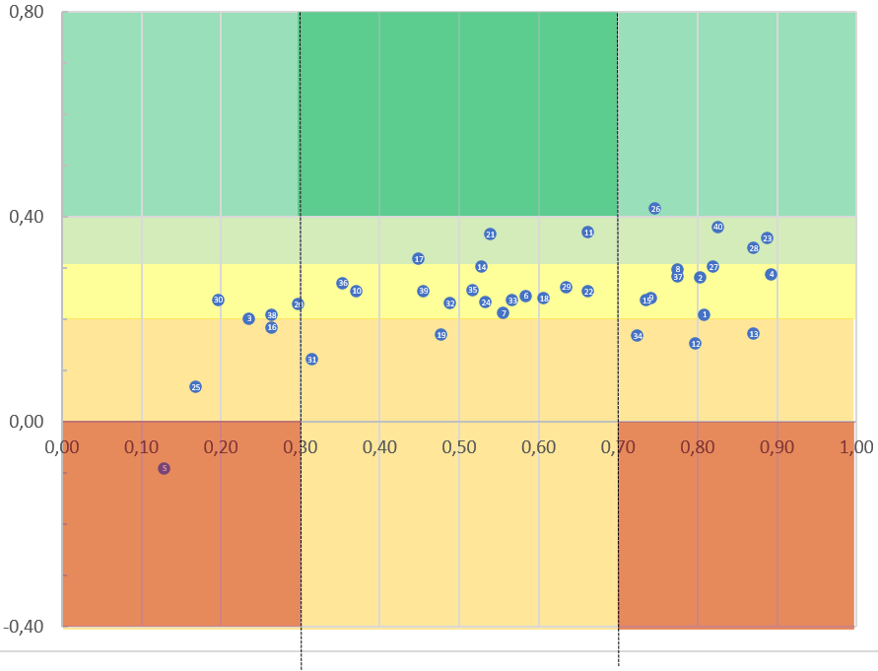
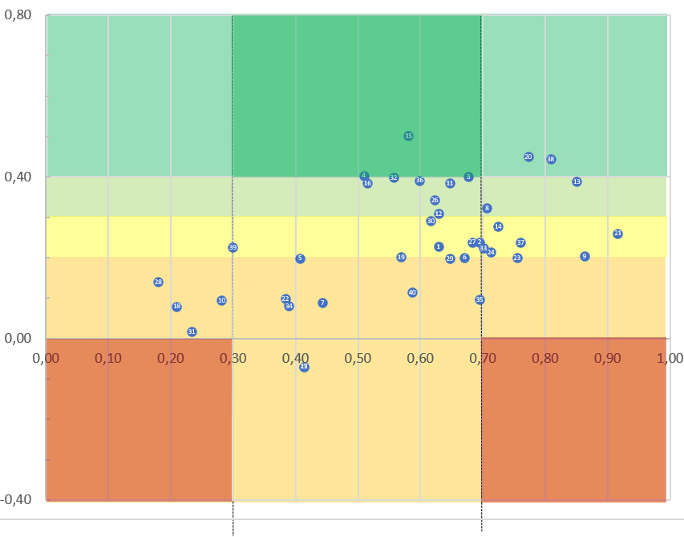
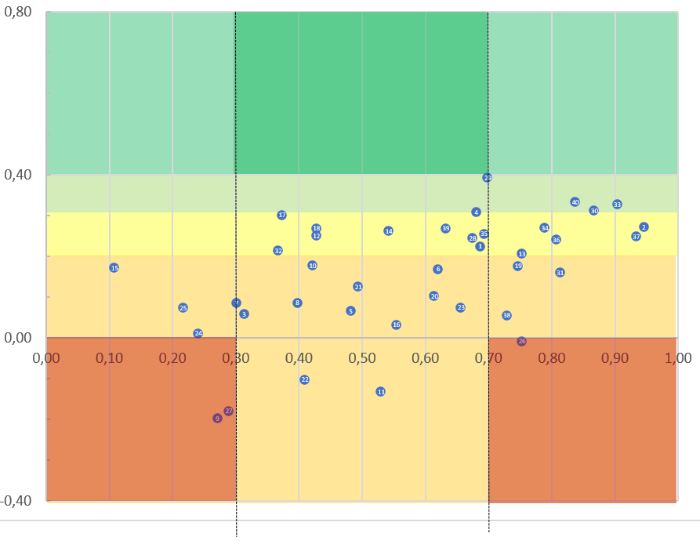
Rit vs P-values
In what country were these photographs taken?
Rit
2021
2018
easy question with strong correlation
2019
hard question with negative correlation
p-value

Slide 6
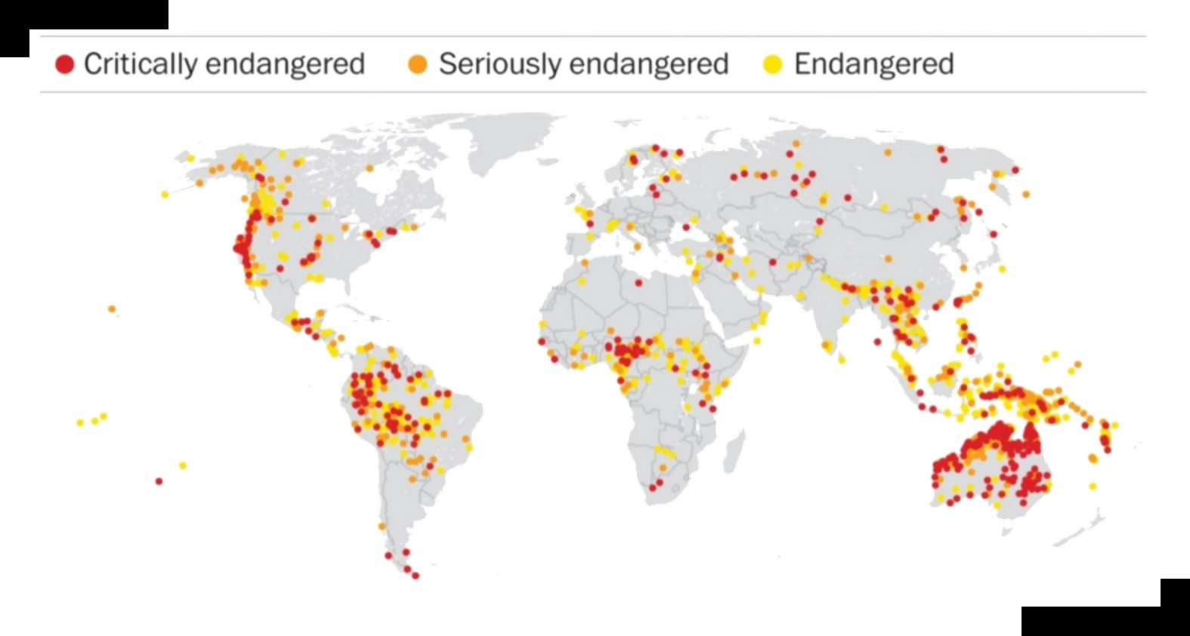
What does this map illustrate?
Q 26
In what country were these photographs taken?
A
At-risk health care
B
At-risk languages
C
At-risk local economies
D
At-risk religions
Notes:
http://revel.unice.fr/eriep/index.html?id=3369&format=print

Slide 7
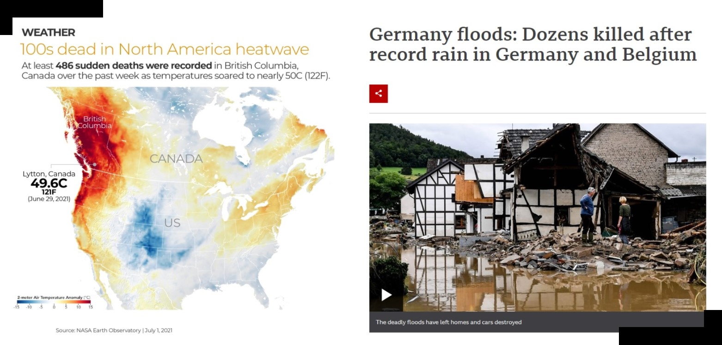
Two news items on extreme heat in North America and floods in Germany and Belgium. How are these two events directly related?
Q 05
In what country were these photographs taken?
A
formation of a heat dome
B
human-induced climate change
C
poor adaptation strategies
D
position of the jet stream
Notes:
http://revel.unice.fr/eriep/index.html?id=3369&format=print

Slide 8
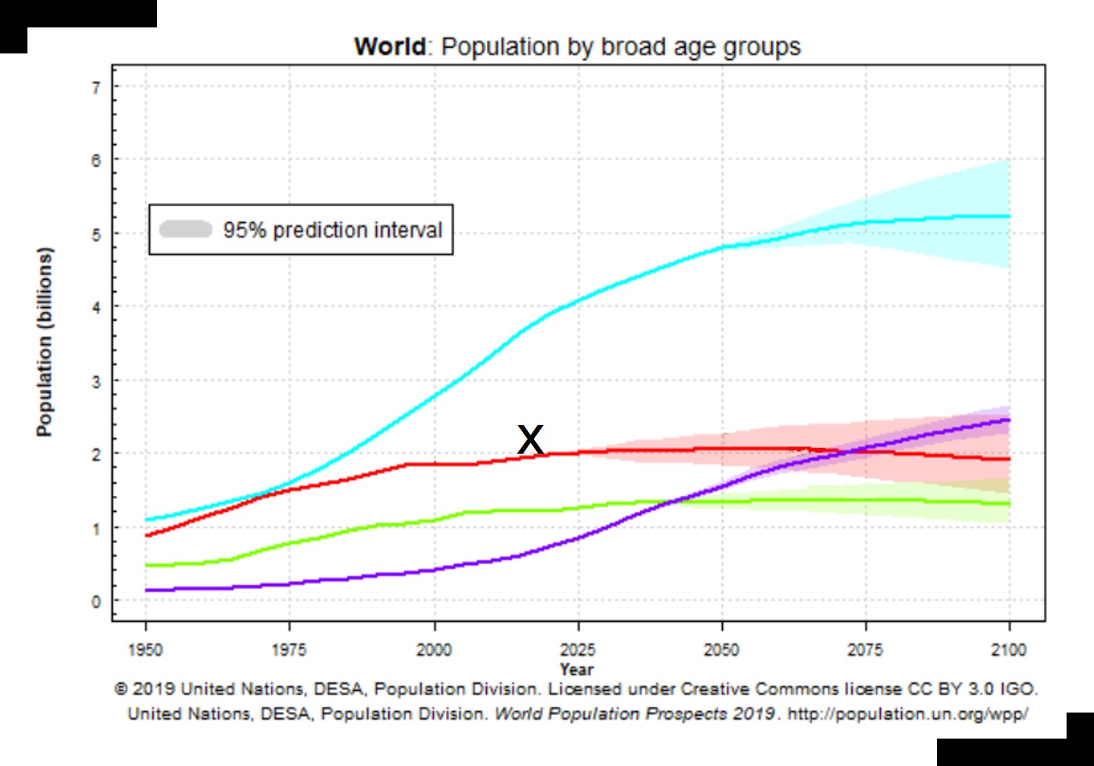
Which age group is indicated with the red line ("X") in this world population prediction graph?
Q 21
In what country were these photographs taken?
A
0-14 years
B
15-24 years
C
25-64 years
D
65+
Notes:
http://revel.unice.fr/eriep/index.html?id=3369&format=print

Slide 9
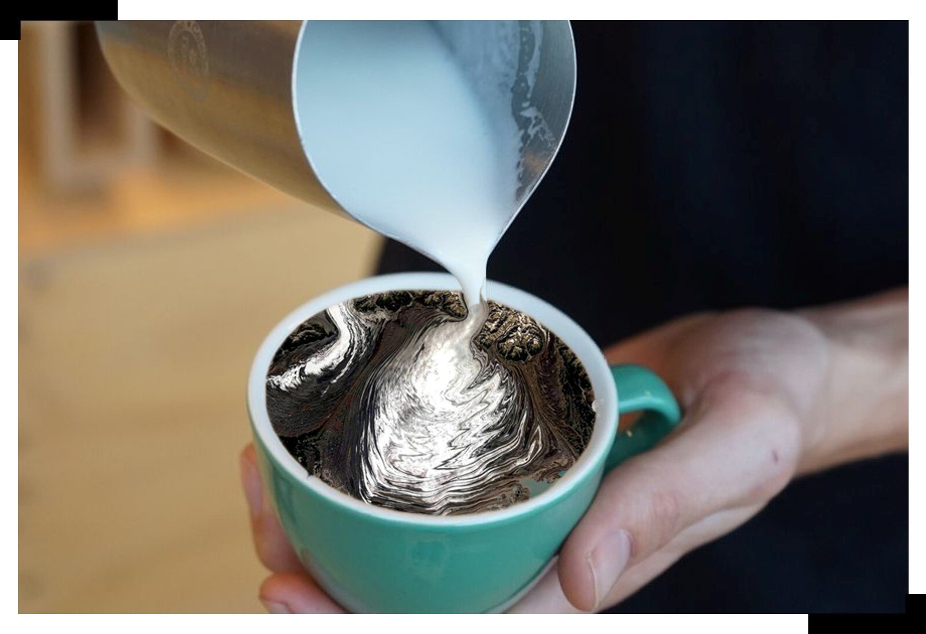
Glacial-latte-art. Which type of glacier is shown in this "Earth-cappuccino"?
Q 10
In what country were these photographs taken?
A
cirque glacier
B
piedmont glacier
C
tidewater glacier
D
valley glacier
Notes:
http://revel.unice.fr/eriep/index.html?id=3369&format=print

Slide 10
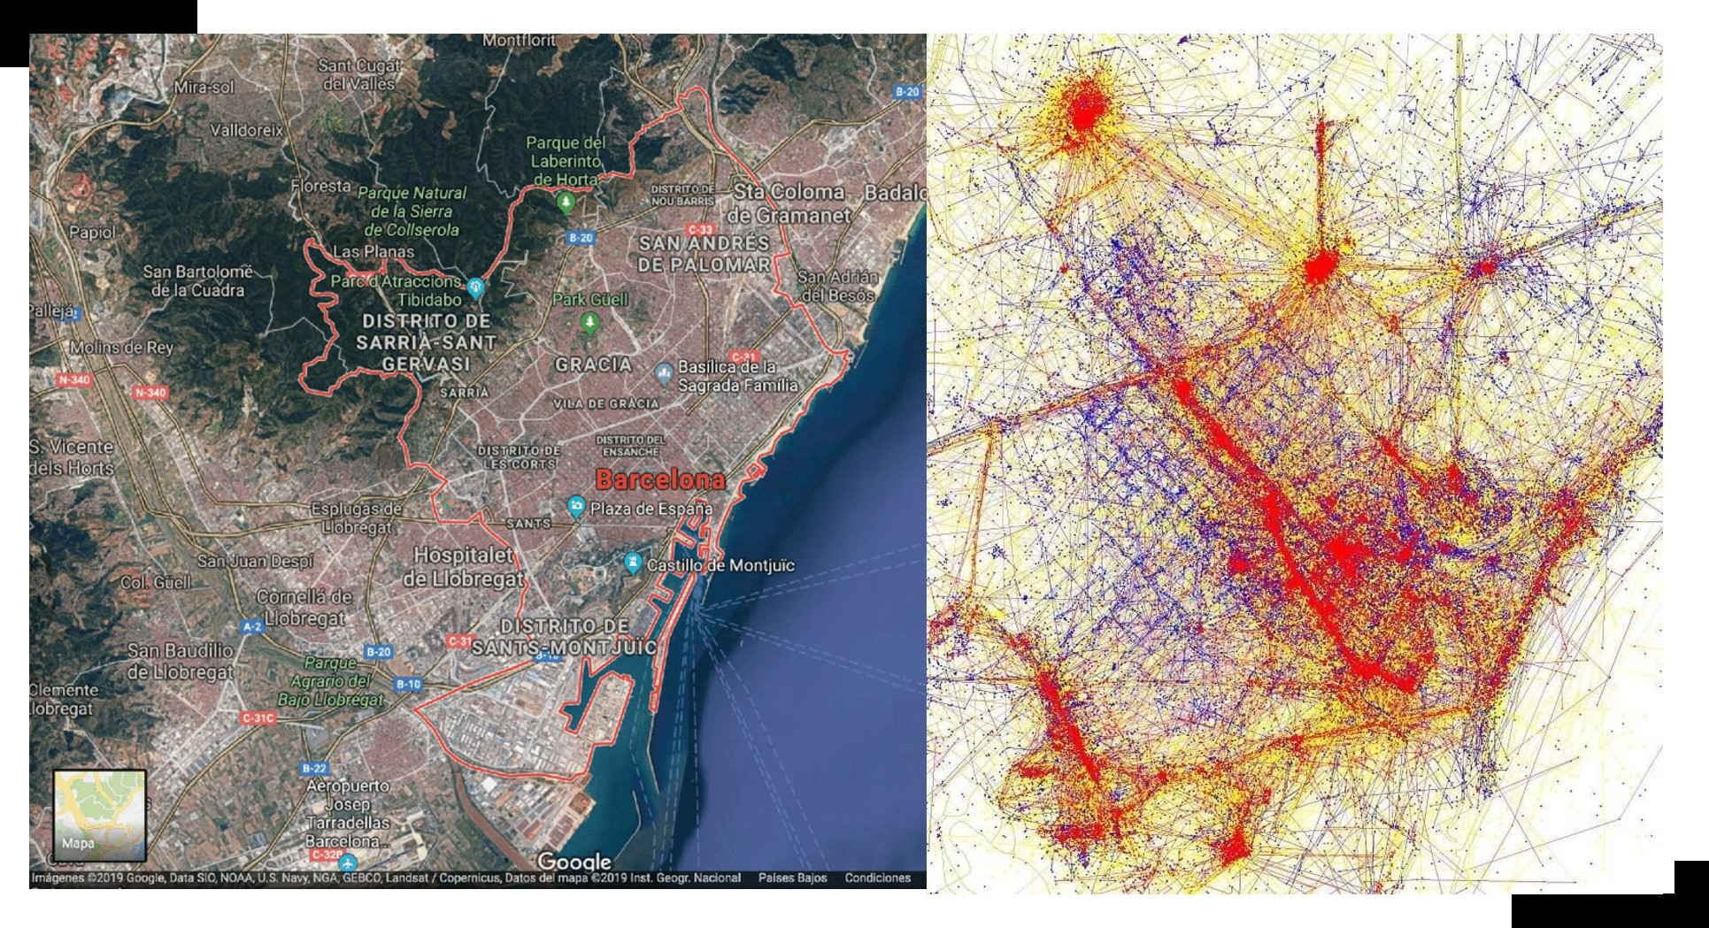
Based on data from Twitter, this map shows how Barcelona is perceived by:
Q 28
In what country were these photographs taken?
Left map: satellite-image of Barcelona
Right map: a Twitter*-based heat map of Barcelona (Spain). The red dots indicate photos taken by GROUP 1, while the blue dots indicate photos taken by GROUP 2 and the yellow dots might be either.
*Twitter is a social media platform.
A
male and female dwellers of Barcelona
B
local dwellers and tourists
C
poor and rich dwellers of Barcelona
D
students (16-25) and eldery (65+)
Notes:
http://revel.unice.fr/eriep/index.html?id=3369&format=print

Slide 11
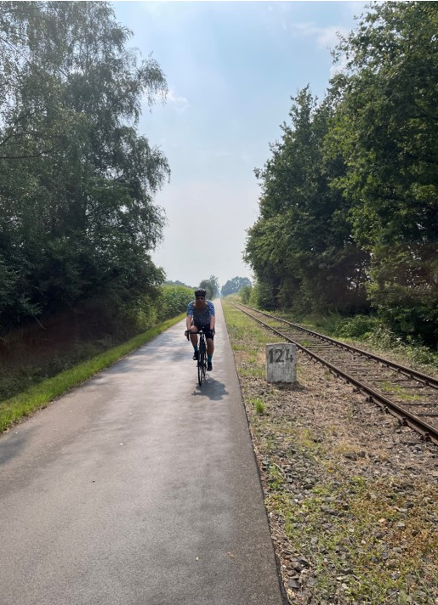
Prospects for next years MMT
In what country were these photographs taken?
Please sent in 50/50 physical and human geography questions
Questions containing a ‘geographical story’ and ‘everyday geographies’
Instructions on which kind of file-types/resource can be used will follow.
2021.08.15
Tim Schuring
MMT convenor

